Slide 1
Research Methodology & IPR Course Code: BTCS4801

Slide 2
What is research?
Research can be defined as the search for knowledge or as any systematic investigation to establish facts.
The Advanced Learner’s Dictionary of Current English lays down the meaning of research as “a careful investigation or inquiry specially through search for new facts in any branch of knowledge”.
In short, the search for knowledge through objective and systematic method of finding solution to a problem is research.

Slide 3
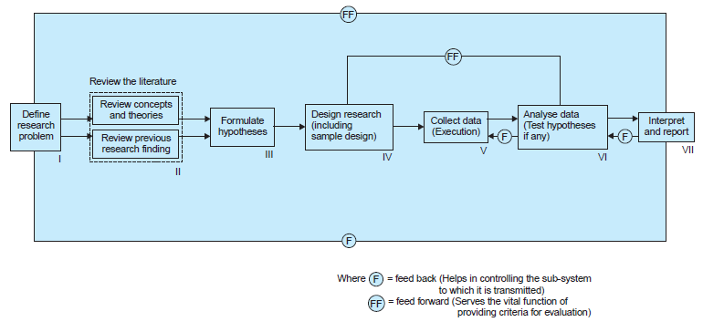
RESEARCH PROCESS FLOW CHART

Slide 4
Research Process Stages
Formulating the research problem
Extensive literature survey
Developing the hypothesis
Preparing the research design
Determining sample design
Collecting the data
7) Execution of the project
8) Analysis of data
9) Hypothesis testing
10) Generalisation and interpretation
11) preparation of the report or presentation of the results,i.e., formal write-up of conclusions reached.

Slide 5
Criteria\ Characteristics of Good Research
Systematic
Logical
Empirical
Reductive
Replicable

Slide 6
Criteria\ Characteristics of Good Research
1. The purpose of the research should be clearly defined and common concepts be used.
2. The research procedure used should be described in sufficient detail to permit another researcher to repeat the research for further advancement, keeping the continuity of what has already been attained.
3. The procedural design of the research should be carefully planned to yield results that are as objective as possible.
4. The researcher should report with complete frankness, flaws in procedural design and estimate their effects upon the findings.
5. The analysis of data should be sufficiently adequate to reveal its significance and the methods of analysis used should be appropriate. The validity and reliability of the data should be checked carefully.
6. Conclusions should be confined to those justified by the data of the research and limited to those for which the data provide an adequate basis.
7. Greater confidence in research is warranted if the researcher is experienced, has a good reputation in research and is a person of integrity.

Slide 7
Problems Encountered by Researchers in India
The lack of a scientific training in the methodology of research
There is insufficient interaction between the university research departments
There is lack of confidence that the information/data obtained will not be misused.
There does not exist a code of conduct for researchers
Difficulty of adequate and timely secretarial assistance
Library management and functioning is not satisfactory at many places
There is also the difficulty of timely availability of published data
The problem of conceptualization

Slide 8
Motivation for Research
Desire to get a good academic profile along with its consequential benefits.
Desire to face the challenge in solving the unsolved problems, i.e., concern over practical problems initiates research.
Desire to get intellectual joy of doing some creative work.
Desire to be of service to society.
Desire to get respectability.

Slide 9
Research problem
In research process, the first and foremost step happens to be that of selecting and properly defining a research problem. Like a medical doctor, a researcher must examine all the symptoms (presented to him or observed by him) concerning a problem before he can diagnose correctly. To define a problem correctly, a researcher must know: what a problem is
A research problem, in general, refers to some difficulty which a researcher experiences in the context of either a theoretical or practical situation and wants to obtain a solution for the same.

Slide 10
Components of Research problem
There must be an individual or a group which has some difficulty or the problem.
There must be some objective(s) to be attained at. If one wants nothing, one cannot have a problem.
There must be alternative means (or the courses of action) for obtaining the objective(s) one wishes to attain. This means that there must be at least two means available to a researcher for if he has no choice of means, he cannot have a problem.
There must remain some doubt in the mind of a researcher with regard to the selection of alternatives. This means that research must answer the question concerning the relative efficiency of the possible alternatives.
There must be some environment(s) to which the difficulty pertains

Slide 11
Errors encountered by Researcher
Some common errors researchers may commit when selecting a research problem:
Vague Problem Statement
Overly Broad or Narrow Problem
Ignoring Relevance and Significance
Lack of Originality
Insufficient Literature Review
Personal Bias
Infeasible Problem
Ignoring Ethical Considerations
Underestimating Resources

Slide 12
Examples
Example: Vague Problem - "Improving Education"
Studying Human Behavior
Specific Problem - "Investigating the Impact of Interactive Online Modules on High School Students' Math Learning Outcomes
Problem - "Exploring the Entire History of Human Civilization" Feasible Problem - "Investigating the Socioeconomic Factors Influencing Urbanization Trends in the Last Three Decades“
Problem: "Analyzing the Impact of Green Tea Consumption on the Concentration Levels of College Students in a Single Geography Classroom"

Slide 13
Sources of Research Problems
Observation and Experience: Research problems can arise from personal observations or experiences that highlight an area needing investigation
Literature Review: Examining existing literature can reveal gaps, inconsistencies, or areas where further research is needed.
Practical Issues or Concerns: Both professional and personal, can inspire researchers to address issues they have encountered
Collaboration with Industry or Institutions: Industry challenges inspire researcher to meet the demand of latest trend.
Expert Consultation: Discussions with experts in a particular field can highlight unresolved questions or areas of concern that require further investigation.

Slide 14
Sources of Research Problems
Technology Advancements: Technological innovations can open up new avenues for research by introducing novel challenges or opportunitie
Policy and Regulation: New policies, regulations, or laws may lead to research inquiries about their effectiveness, unintended consequences, or areas needing improvement
Global Events and Crises: Major events such as natural disasters, pandemics, or geopolitical conflicts can generate research questions related to response strategies, recovery efforts, and long-term impacts.

Slide 15
Scope and Objectives of research problem
The scope and objectives of a research problem define the boundaries and goals of a research study. They provide clarity and direction for the research process, helping researchers focus their efforts and guide the development of the study.
Geographical Scope
Temporal Scope
Population/Participants
Variables
Main Objective
Specific Objectives
Hypotheses or Research Questions
Methodological Objectives
Practical or Applied Objectives

Slide 16
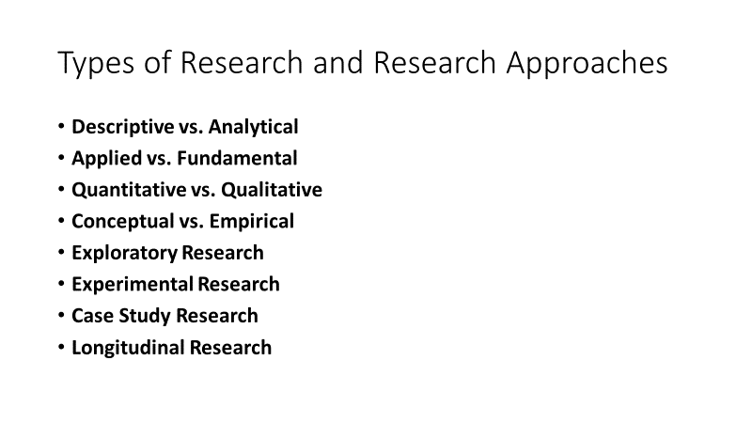

Slide 17
Approaches of Investigation of Solutions
Inferential approach: Inferential approach to research is to form a data base from which to infer characteristics or relationships of population.
Survey Approach: Surveys involve collecting data from a larger population through questionnaires or interviews.
Case Study Approach: A case study involves an in-depth exploration of a single entity, such as an individual, organization, event, or phenomenon.
Mixed-Methods Approach: This approach combines both quantitative and qualitative methods. Researchers collect and analyze both numerical and non-numerical data to gain a comprehensive understanding of the research problem.
Action research: It is often used in practical or applied settings. It involves researchers collaborating with stakeholders to identify problems, implement interventions, and evaluate the outcomes.

Slide 18
Approaches of Investigation of Solutions
Grounded Theory Approach: This approach is commonly used in social sciences to develop theories from empirical data. Researchers gather data and then systematically code and analyze it to derive concepts and theories that are "grounded" in the data itself.
Qualitative approach: This approach is concerned with subjective assessment of attitudes, opinions and behavior. Research in such a situation is a function of researcher’s insights and impressions.
Often, a combination of approaches might be used to address different aspects of the problem and provide a more comprehensive understanding of the solutions.

Slide 19
Approaches of Investigation of Solutions
Data Collection: This could include surveys, interviews, observations, experiments, or analysis of existing datasets.
Analysis: Analysis refers to the process of examining and interpreting the collected data. The aim is to uncover patterns, trends, relationships, and insights within the data.
Interpretation: This step often involves explaining the implications of the findings and discussing their significance.
Necessary Instrumentation: Physical Tools, Software Tools, Questionnaires or Surveys, Observational Protocols, Experimental Setups

Slide 20
Effective Literature Study approaches
Define Research Objectives: Clearly outline the purpose of your literature review, whether it's to provide background information, identify gaps, or support a specific research question.
Search Strategy: Develop a comprehensive search strategy using appropriate keywords, Boolean operators, and databases to ensure a thorough exploration of relevant literature
Screening Process: Review titles and abstracts of identified sources to determine their potential relevance to your research.

Slide 21
Effective Literature Study approaches
Data Extraction: Systematically extract key information from selected sources, including author, publication year, methodology, findings, and implications.
Categorization: Group sources into themes, topics, or concepts to organize the literature and identify patterns.
Critical Evaluation: Assess the quality and credibility of each source, considering factors like author expertise, methodology, bias, and peer-review status.
Synthesis: Summarize and synthesize findings from different sources, highlighting common themes, disagreements, and gaps in the existing literature.

Slide 22
Effective Literature Study approaches
Conceptual Framework: Develop a conceptual framework that illustrates how different studies relate to each other and contribute to your research.
Citations and References: Properly cite and reference all sources according to the appropriate citation style (APA, MLA, Chicago, etc.).
Visual Aids: Consider creating visual aids like tables, graphs, or concept maps to illustrate relationships between studies and concepts.
Critical Analysis: Analyze the strengths and weaknesses of the existing literature, identifying limitations, contradictions, and potential biases.

Slide 23
Effective Literature Study approaches
Integration with Research: Integrate the findings of the literature review into your research project, showing how it informs your research objectives, hypotheses, or research questions.
Future Research Directions: Highlight areas where further research is needed, pointing out gaps in the current literature that your study could address.
Revision and Updating: Regularly update and revise your literature review as new research emerges, ensuring it remains current and relevant.
Citation Management: Utilize citation management tools to organize, store, and cite your sources efficiently.
Ethical Considerations: Ensure ethical practices in referencing, giving credit to original authors, and avoiding plagiarism.

Slide 24
Effective Literature Study approaches
Patents and Innovations: Explore patents related to your area of interest to understand technological innovations and trends.
Academic Books: Consult academic books written by experts in the field for comprehensive overviews and theoretical foundations.
Technical Blogs and Forums: Engage with technical blogs, forums (like Stack Overflow), and community platforms to gain insights from practitioners and researchers.
Cross-Referencing: Look through the references cited in papers and articles to find additional sources that contribute to your understanding
Coding Patterns and Algorithms: For software-related studies, investigate coding patterns, algorithms, and design methodologies to gain insights into best practices

Slide 25
Effective Literature Study approaches
Open Source Projects: For software-related studies, analyze open source projects to understand coding practices, collaboration patterns, and real-world applications
GitHub Repositories: For software-related studies, consider looking at code repositories on platforms like GitHub to understand practical implementations.
Whitepapers and Technical Reports: Investigate whitepapers, technical reports, and documentation from reputable sources like research institutions and technology companies.

Slide 26
Plagiarism Analysis
There are various approaches to analyzing plagiarism:
Text Comparison Software: Utilize plagiarism detection tools like Turnitin, Grammarly, and ithenticate that compare the submitted text against databases of existing content to identify similarities.
Manual Comparison: Conduct a side-by-side analysis of the suspected plagiarized content and its potential source to identify direct copying or paraphrasing.
Citation Examination: Scrutinize the citations and references in the document to check if sources have been appropriately credited and cited.
Semantic Analysis: Look beyond literal text matching and assess the overall meaning and structure of sentences to detect disguised plagiarism.
Writing Style Analysis: Evaluate changes in writing style, vocabulary, tone, or formatting that may indicate portions of text copied from another source.

Slide 27
Plagiarism Analysis
Online Search: Manually search for specific phrases or sentences online to identify potential sources of copied content.
Cross-Reference with Databases: Compare the document with academic databases, journals, and published materials to spot unauthorized use of others' work.
Peer Review: In academic and research settings, peer reviewers can help identify potential instances of plagiarism by recognizing unattributed content.
Pattern Recognition: Identify recurring patterns in sentence structure, keywords, or ideas that might indicate similarities with existing sources.
Quotation Verification: Ensure that quoted material is accurately presented and properly cited to prevent inadvertent plagiarism.
Synonym Checks: Search for synonyms of key phrases to uncover instances where authors have replaced words to evade direct matching.

Slide 28
Plagiarism Analysis
Historical Record Analysis: Review historical drafts or versions of the document to detect changes or additions that could suggest copied content.
Expert Assessment: Seek input from subject matter experts to identify content that deviates from the author's usual style or knowledge.
Language Analysis: Analyze linguistic nuances, idiomatic expressions, or grammatical inconsistencies that might reveal copied content.
Google Reverse Image Search: For visual content, use reverse image search engines to locate instances of image plagiarism.
Digital Forensics: Employ digital forensics techniques to uncover hidden metadata or traces of copying in electronic documents.
Statistical Analysis: Apply statistical tools to analyze word frequency, sentence length, or other patterns that may indicate copied content.

Slide 29
Plagiarism Analysis
Contextual Assessment: Consider the context of the suspected plagiarism, the author's credibility, and the likelihood of accidental similarity.
Plagiarism Detection Services: Engage third-party services that specialize in plagiarism detection and offer in-depth analysis.
Combination Approach: Employ multiple methods in tandem for a more comprehensive and accurate plagiarism analysis.

Slide 30
Research Ethics
Informed Consent: Obtain clear and voluntary agreement from participants, explaining the purpose, procedures, risks, and benefits of the study.
Confidentiality: Safeguard participants' privacy by keeping their personal information and data confidential.
Minimization of Harm: Take measures to minimize physical, psychological, or emotional harm to participants during the research.
Objectivity and Integrity: Conduct research honestly, transparently, and without manipulating data or results.
Respect for Participants: Treat participants with dignity, avoiding coercion, discrimination, or exploitation.

Slide 31
Research Ethics
Avoidance of Bias: Strive to remain unbiased in design, execution, and reporting to ensure research accuracy.
Responsible Authorship: Credit individuals who significantly contributed as authors, avoid plagiarism and guest authorship.
Data Management: Handle data securely, maintaining accuracy, confidentiality, and appropriate retention.
Compliance with Regulations: Adhere to legal and institutional research ethics guidelines and approvals.
Conflict of Interest Disclosure: Declare any personal or financial interests that could affect research objectivity.
Publication Ethics: Publish findings transparently, with proper citation, accurate reporting, and avoidance of duplication.

Slide 32
Research Ethics
Responsibility to Society: Conduct research that benefits society, addresses needs, and contributes positively.
Maintain Credibility: Uphold ethical standards to ensure the integrity and credibility of research outcomes.

Slide 33
Effective Technical Writing
Audience Understanding
Clarity and Direct Language
Conciseness and Eliminating Redundancy
Organizational Structure
Visual Aids and Illustrations
Consistency in Terminology and Style
Precise Terminology and Definitions
Avoiding Ambiguity

Slide 34
Effective Technical Writing
Proper Citation and Referencing
Proofreading and Editing
Providing Context
Balancing Technical Detail
Iterative Revision Process
Seeking Audience Feedback

Slide 35
Core collection of WEB of Science
Science Citation Index Expanded (SCIE)
Social Sciences Citation Index (SSCI)
Arts & Humanities Citation Index (AHCI)
Emerging Sources Citation Index (ESCI)
Conference Proceedings Citation Index (CPCI)
Book Citation Index (BKCI)
Index Chemicus (IC) and Current Chemical Reactions (CCR)
Current Contents Connect

Slide 36
Why Research Report
A research report is a formal account of how a research project was conducted and what it found out. With it, people interested in the project can:
• Read about the project’s aims, methods and findings.
• Assess the quality of the project.
• Provide feedback to the project’s researchers on what they like or dislike about the project.
• Incorporate aspects of the project’s methods or findings into their own work or thinking.

Slide 37
Types of research report
Three of the most common types of research report are
• Technical reports
• Manuscripts for journal articles
• Thesis and dissertations.

Slide 38
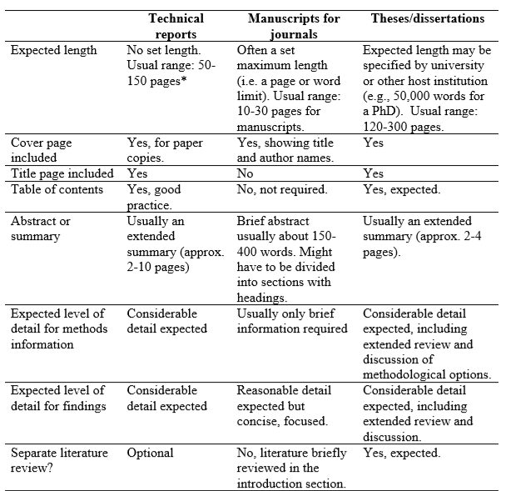

Slide 39
Common structure for a technical report
• Cover page with title and author(s) details
• Contents page
• Summary or abstract
• Acknowledgements
• Introduction
• Methods
• Results (or Findings)
• Discussion and conclusions
• References
• Appendices

Slide 40
Common writing errors in research reports
• Writing lacks clarity. Sentences not easily understood
• Key information not provided (e.g., sample sizes, context for the research project)
• Most important findings not highlighted
• Trivial information highlighted in tables and graphs
• Page numbers not inserted
• Information not presented in a clear, logical sequence
• No blank line or indented text used to mark new paragraphs
• Symbols and abbreviations used in the text are not explained
• Tables not self-explanatory

Slide 41
• Table and figure titles are too long or do not clearly describe what the table or figure contains.
• Figures difficult to understand (e.g., too complex).
• Numerous spelling and grammatical errors.
• Starting a new line for each sentence (i.e. using one-sentence paragraphs).
• References in text and reference list are incorrectly formatted.

Slide 42
Research Proposal
A research proposal is a structured, formal document that explains what you plan to research (your research topic), why it’s worth researching (your justification), and how you plan to investigate it (your methodology)
1. Title page
2. Topic of a research
3. Introduction
4. Rationale and research question
5. Literature Review
6. Aim and Objectives
7. Methodology
8. Ethical Consideration
9. Budget
10. Timeline
11. Conclusion
12. References/ bibliography

Slide 43
Nature of Intellectual property
Intellectual Property (IP) refers to creations of the mind, such as inventions, literary and artistic works, designs, symbols, names, and images used in commerce. IP is protected by law through patents, designs, trademarks, and copyrights, enabling creators to control and benefit from their intellectual creations.
Patent: A patent is a type of intellectual property right which allows the holder of the right to exclusively make use of and sale an invention when one develops an invention. Invention is a new process, machine, manufacture, composition of matter.
Designs: Industrial designs refer to the aesthetic aspects of articles, such as the visual design and ornamental features. Protecting a design prevents others from making, selling, or using similar designs without permission. This protection can help businesses differentiate their products and foster creativity in various industries.

Slide 44
Nature of Intellectual property
Trademarks: A trademark is a unique symbol, word, phrase, design, or combination thereof that distinguishes and identifies goods or services offered by a specific source. Trademarks play a significant role in branding and consumer recognition. Registration provides exclusive rights to the trademark owner, preventing others from using a similar mark in a way that could cause confusion.
Copyrights: Copyright protects original works of authorship, such as literary, artistic, and musical works, as well as software, films, and architectural designs. The creator of a copyrighted work has the exclusive right to reproduce, distribute, perform, display, or create derivative works based on that work. Copyright protection is automatic upon creation and generally lasts for the creator's lifetime plus a certain number of years after their death.

Slide 45
Nature of Intellectual property
Trade Secrets: Trade secrets are valuable business information that is not generally known to the public and is subject to reasonable efforts to maintain its secrecy. Examples include formulas, processes, customer lists, and marketing strategies. Unlike patents or copyrights, trade secrets do not require registration and offer protection as long as the information remains confidential.

Slide 46
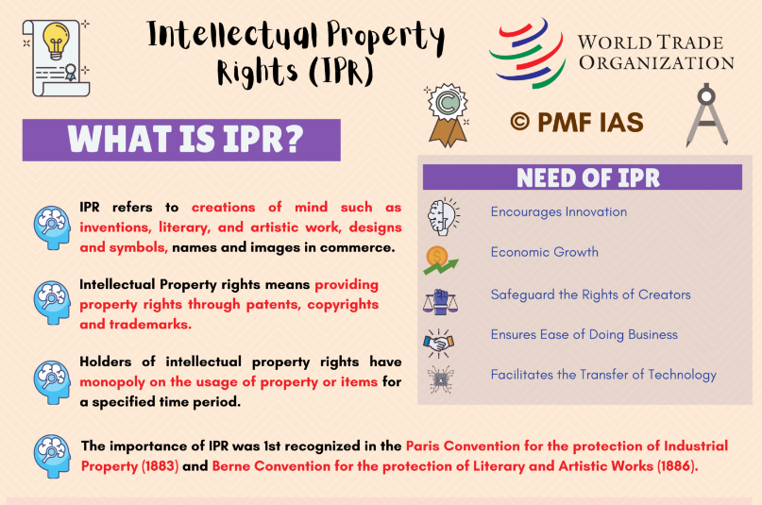
Source: pmfias.com

Slide 47
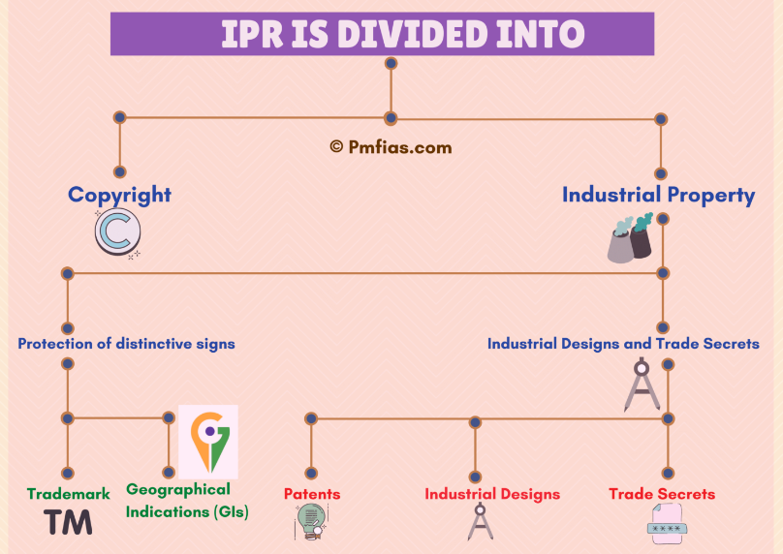

Slide 48
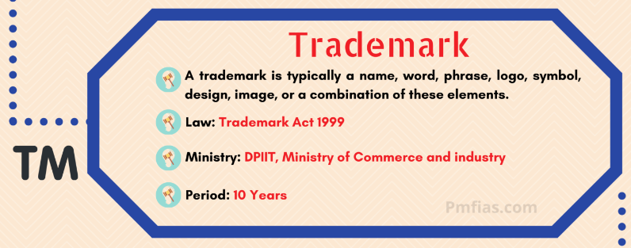

Slide 49
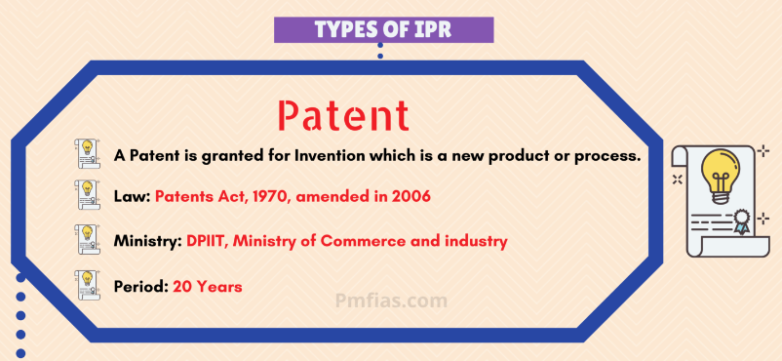

Slide 50
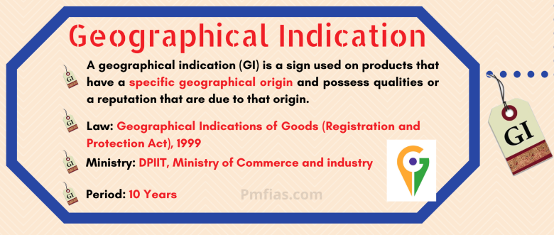

Slide 51
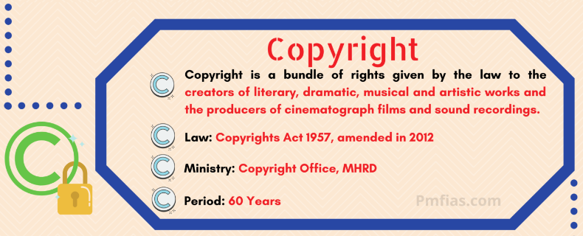

Slide 52
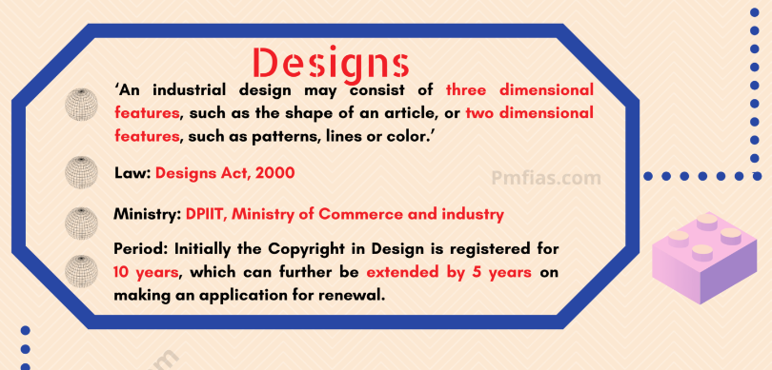

Slide 53


Slide 54
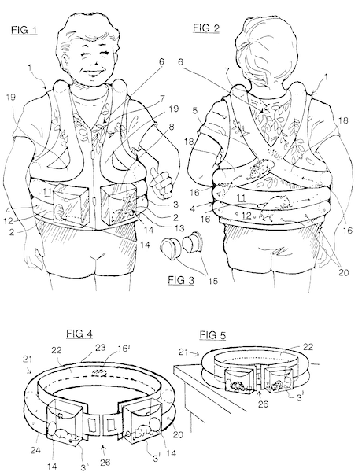
Wearable Pet Display

Slide 55
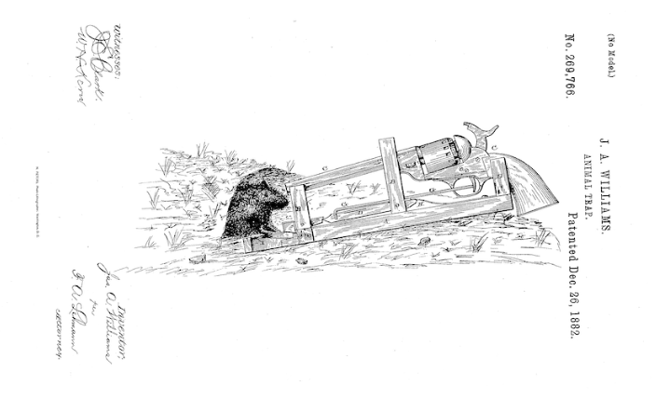
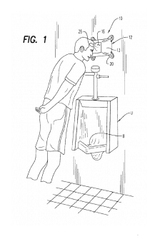
Urinal Headrest
Rodent Blaster

Slide 56
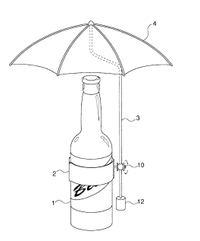
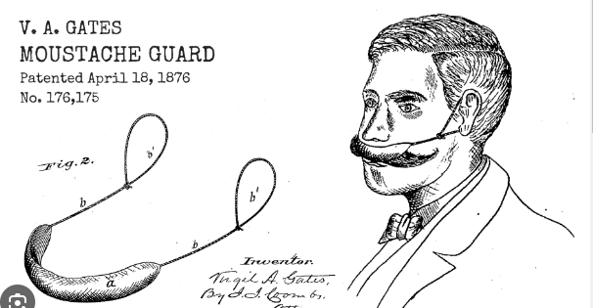
Beerbrella

Slide 57
What does a patent do?
Protects intellectual property for 20 years no one else can manufacture the product
some one can pay you royalties
you can block competitors
After 20 years, technology goes to public domain

Slide 58
The page on Patents on website of the Intellectual Property Office, India can be accessed at http://ipindia.nic.in/ipr/patent/patents.html

Slide 59
Importance of patents
Important source of scientific and technical literature
A treasure-house of scientific inventions
Avoids duplication
Paves way for further discoveries
Stop re-inventing the wheel
Identifies emerging technologies, emerging areas

Slide 60
What are Patent Rights
To prevent third party without authorization-
Making or manufacturing
Using,
Offering for sale
Selling,
Importing
Distributing
Licensing

Slide 61
What is an Invention?
Sec.2(1)(j)
“Invention”means a new product or process involving an inventive step and capable of industrial application.
Three basic criteria which any invention must meet in order to deserve a patent:
Novelty
Non-obviousness
Industrial application

Slide 62
Patentable subject matter
Invention must
relates to a Processor Productor both
be new(Novel)
involves an inventive step
be capable of industrial application
not fall under Section 3 and 4

Slide 63
“NEW”MEANS
Invention must not be
Published in India or elsewhere
In prior public knowledge or prior public use with in India
Claimed before in any specification in India
A feature of an invention that
Involves technical advance as compared to the existing knowledge or
Have economic significance or both and
Makes the invention not obvious to a person skilled in the art.

Slide 64
What is not Patentable
Inventions falling within the scope of Sec. (3) of Patents Act, 1970.
Inventions falling within the scope of Sec. (1) of Sub-sec. 20 of Atomic Energy Act, 1962-
For Example : Inventions relating to Compounds of –
Uranium, Beryllium, Thorium, Plutonium, Radium, Graphite, Lithium and more as notified by Central Govt. from time to time

Slide 65
Inventions Not Patentable -Sec 3
3(f): the mere arrangement or re-arrangement or duplication of known devices each functioning independently of one another in a known way.
3(a): frivolous or anything obviously contrary to well established natural laws.
3(b): contrary public order or morality serious prejudice to human, animal or plant life or health or to the environment.
3(c): the mere discovery of a scientific principle or the formulation of an abstract theory or discovery of any living thing or non-living substances occurring in nature.
3(d): the mere discovery of a new form of a known substance which does not result in the enhancement of the known efficacy of that substance.
3(e): a substance obtained by a mere admixture resulting only in the aggregation of the properties of the components there of or a process for producing such substances.
3(h): a method of agriculture or horticulture.

Slide 66
Inventions Not Patentable -Sec 3
3(m):mere scheme or rule or method of performing mental act or method of playing game3(l):a literary, dramatic, musical or artistic work or any other aesthetic creation
3(o):topography of integrated circuits
3(p):an invention which in effect is traditional knowledge or which is an aggregation or duplication of known properties or traditionally known component or components.
3(i):any process for the medicinal, surgical, curative, prophylactic, diagnostic, therapeutic or other treatment of animals to render them free of disease or to increase their economic value or that of their products.
3(j): plants & animals in whole or any part thereof other than microorganisms but including seeds, varieties and species and essentially biological processes for the production or propagation of plants and animals;
3(k): a mathematical or business method or a computer programme or algorithms

Slide 67
Process of Patenting
Be curious but do not disclose your invention
Keep a bound notebook to prove when you got the idea
Develop the idea and produce a model
Write why your invention is needed, what the existing products are in the market, your new product, and what is unique about your product

Slide 68
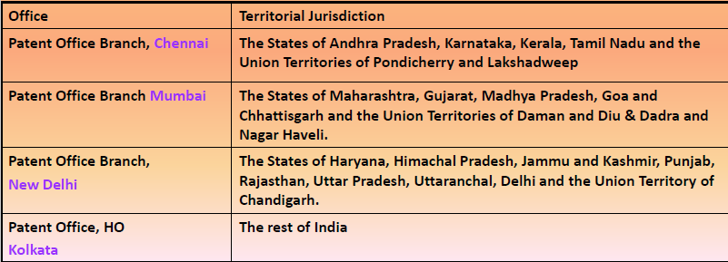
Where to file patent application

Slide 69
How to file a patent application?
through online( e-filing) or
www.ipindiaonline.gov.in/online
through post or
can be submitted by hand

Slide 70
GENERAL PROCEDURE FOR OBTAINING A PATENT
Filing of patent application
Publication after 18 months
Pre Grant Opposition /Representation by any person.
Request for examination
Examination: Grant or Refusal
Publication of Grant of patent
Post Grant Opposition to grant of patent
Decision By Controller

Slide 71
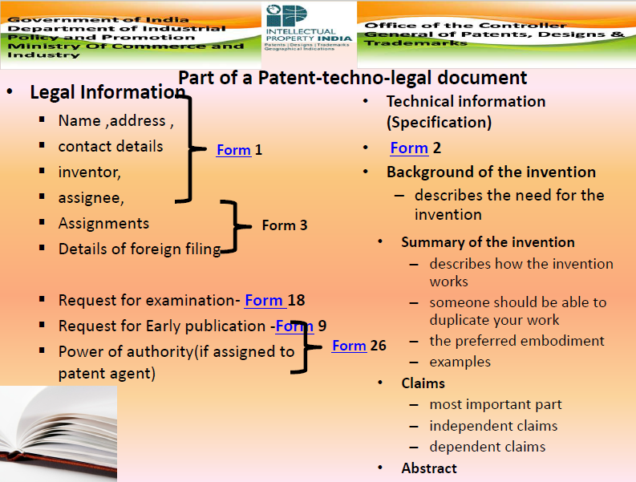

Slide 72
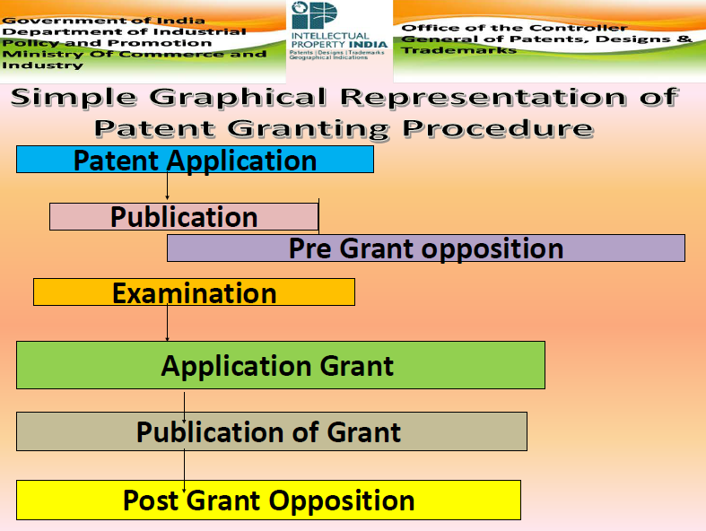

Slide 73
Who can file Patent Application
In India [Section 6 and 134]
The application can be filed either alone or jointly:
By any person claiming to be true and first inventor(s)
By any person being the assignee of person claiming to be true and first inventor(s)
( proof of assignment has to be submitted along with the application)
By the legal representative of any deceased person or assignee

Slide 74
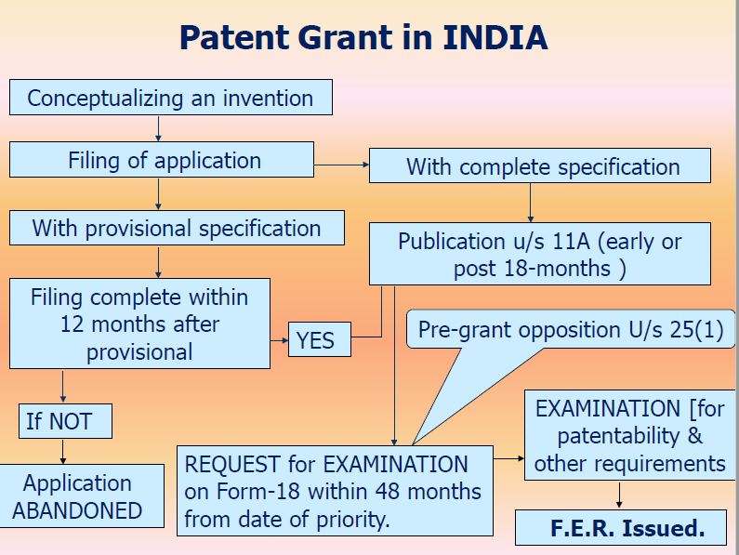

Slide 75
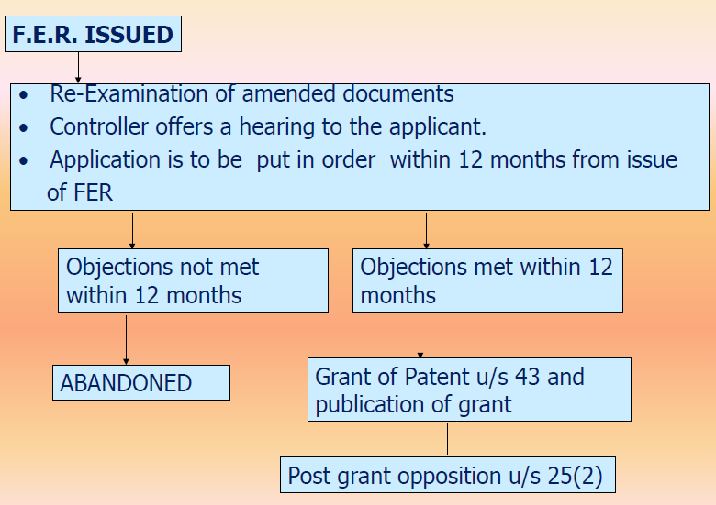

Slide 76
International cooperation on Intellectual Property.
International cooperation on intellectual property (IP) is essential in a globally connected world where ideas, innovations, and technologies often transcend national boundaries. Governments, organizations, and international bodies collaborate to establish common standards, facilitate trade, and ensure that intellectual property rights are respected and protected.
World Intellectual Property Organization (WIPO): WIPO is a specialized agency of the United Nations dedicated to promoting IP protection and cooperation worldwide. WIPO administers various treaties, including the Paris Convention for the Protection of Industrial Property and the Agreement on Trade-Related Aspects of Intellectual Property Rights (TRIPS).

Slide 77
TRIPS Agreement:
Under the World Trade Organization (WTO), the TRIPS Agreement sets out minimum standards for IP protection and enforcement that member countries are required to implement. It covers patents, copyrights, trademarks, trade secrets, and more.
Harmonization of Laws and Regulations:
Countries work to align their IP laws and regulations to minimize discrepancies and create a more consistent global framework for IP protection.
WIPO facilitates discussions and negotiations among member states to harmonize practices and standards.

Slide 78
Information Sharing and Capacity Building:
Developing countries often require support to establish effective IP systems. International organizations provide technical assistance, training, and capacity-building programs to help nations develop their IP infrastructure and expertise.
Patent Cooperation and Examination:
The Patent Cooperation Treaty (PCT), administered by WIPO, simplifies the process of seeking patent protection in multiple countries. It allows applicants to file a single international patent application that is recognized by numerous member states.
International Patent Offices cooperate in the search and examination of PCT applications, improving efficiency and reducing duplication of efforts.

Slide 79
Combatting Counterfeiting and Piracy:
International cooperation is crucial to combat the global trade of counterfeit goods and pirated content. Collaboration involves sharing information, best practices, and enforcement strategies.
Organizations like INTERPOL and the World Customs Organization (WCO) play a role in addressing counterfeiting and piracy.
Access to Essential Medicines and Technology Transfer:
In certain cases, international agreements and initiatives aim to ensure access to essential medicines, especially in developing countries, while respecting patent rights. This can include compulsory licensing and technology transfer arrangements.

Slide 80
Dispute Resolution:
International mechanisms, such as the WTO's Dispute Settlement Body, handle disputes related to IP rights and trade-related issues. Member countries can bring cases against others for alleged violations of IP agreements.
Digital and Online IP Challenges:
The digital age presents unique challenges related to copyright enforcement, digital piracy, and online infringement. International cooperation is needed to address these issues effectively.

Slide 81
Global Innovation and Research Collaboration:
International collaboration promotes joint research and innovation efforts across borders. Organizations and researchers share knowledge, expertise, and resources for scientific advancement.
Bilateral and Regional Agreements:
Countries often enter into bilateral and regional agreements to enhance IP cooperation. These agreements can cover topics like IP protection, enforcement, and cooperation on specific technologies.

Slide 82
PCT
The PCT is an international treaty with more than 155 Contracting States. The PCT makes it possible to seek patent protection for an invention simultaneously in a large number of countries by filing a single “international” patent application instead of filing several separate national or regional patent applications. The granting of patents remains under the control of the national or regional patent Offices in what is called the “national phase”.
PCT Procedure Includes:
Filing: You file an international application with a national or regional patent Office or WIPO, complying with the PCT formality requirements, in one language, and you pay one set of fees.
International Search: An “International Searching Authority” (ISA) (one of the world’s major patent Offices) identifies the published patent documents and technical literature (“prior art”) which may have an influence on whether your invention is patentable, and establishes a written opinion on your invention’s potential patentability.
International Publication: As soon as possible after the expiration of 18 months from the earliest filing date, the content of your international application is disclosed to the world.

Slide 83
Supplementary International Search (optional): a second ISA identifies, at your request, published documents which may not have been found by the first ISA which carried out the main search because of the diversity of prior art in different languages and different technical fields.
International Preliminary Examination (optional): one of the ISAs at your request, carries out an additional patentability analysis, usually on a version of your application which you have amended in light of content of the written opinion.
National Phase: after the end of the PCT procedure, usually at 30 months from the earliest filing date of your initial application, from which you claim priority, you start to pursue the grant of your patents directly before the national (or regional) patent Offices of the countries in which you want to obtain them.

Slide 84
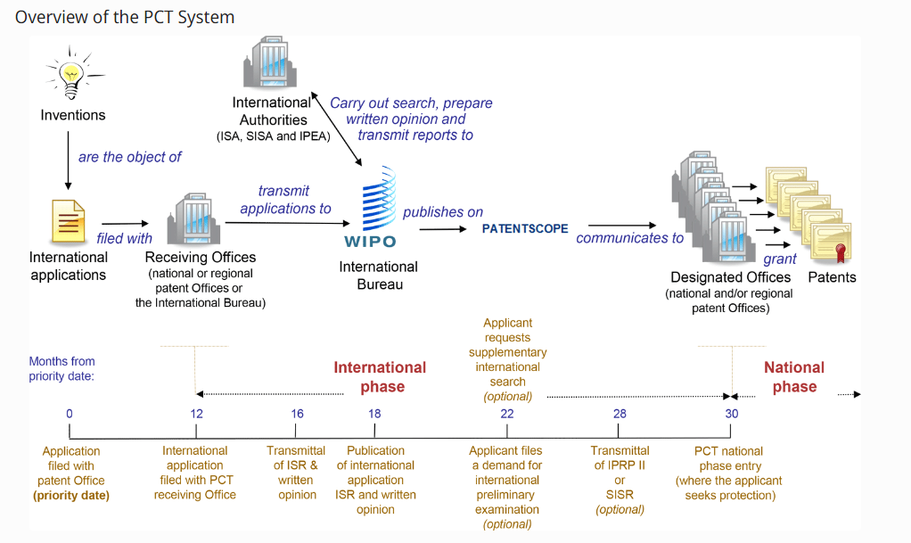

Slide 85
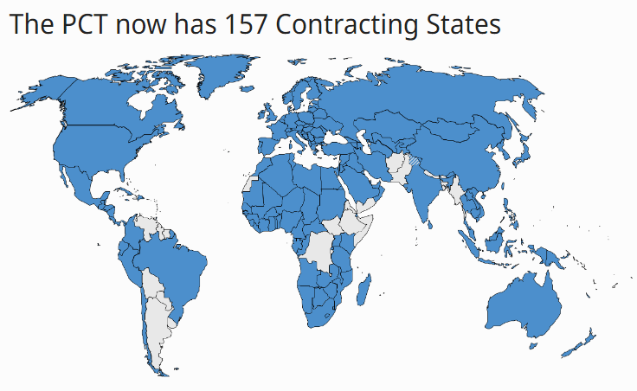
Filing patent applications under PCT implies securing legal protection for an invention under patent law in more than 150 countries at once

Slide 86
New Developments in IPR: Administration of Patent System
Digitization and Online Filing: Many patent offices around the world have been increasingly moving toward digitization of patent applications and the entire patent process. This includes online filing, electronic document management, and the availability of digital resources for patent applicants and examiners.
Artificial Intelligence (AI) and Machine Learning: Some patent offices have started to integrate AI and machine learning into their processes. This technology is used for tasks like prior art searches and automated patent classification, making the patent examination process more efficient.

Slide 87
Global Harmonization: Efforts have been made to harmonize patent systems and processes on a global scale. Initiatives like the Patent Cooperation Treaty (PCT) and the Global Patent Prosecution Highway (GPPH) have aimed to streamline international patent applications and examination.
Expedited Examination: Many patent offices offer expedited examination options for certain types of patents or in specific industries to accelerate the patent grant process.
Quality Improvement: Patent offices are focusing on enhancing the quality of granted patents. This includes improving patent examination processes to ensure that only valid and innovative patents are granted.
Transparency and Accessibility: There is a growing emphasis on making patent data more accessible to the public. Some patent offices have introduced open data initiatives, providing public access to patent information for research and innovation purposes.
Patent Databases and Search Tools: Patent offices have continued to invest in and improve their patent databases and search tools, making it easier for inventors, researchers, and businesses to conduct prior art searches and monitor the patent landscape.

Slide 88
Collaboration with Industry: Patent offices are increasingly engaging with industry stakeholders to understand their specific needs and challenges. This collaboration helps in tailoring patent systems to better serve different sectors.
Green Technologies and IP: Some patent offices are introducing initiatives to encourage and prioritize patents related to green and sustainable technologies. This supports innovation in areas crucial for addressing environmental challenges.
User-Friendly Processes: Patent offices are working on simplifying and streamlining the patent application and examination process to make it more user-friendly, especially for small and medium-sized enterprises (SMEs).

Slide 89
Scope of Patent Rights
Exclusive Rights: Patents grant the holder exclusive rights to make, use, sell, and import the patented invention. This means that others are generally prohibited from engaging in these activities without the patent holder's permission.
Territorial Scope: Patent rights are typically granted on a territorial basis. A patent holder's exclusive rights apply only within the jurisdiction where the patent is granted. To protect the invention in multiple countries, the inventor may need to apply for patents in each relevant jurisdiction.
Duration: Patent rights have a limited duration. The exact duration varies by country but is usually 20 years from the filing date of the patent application. After this period, the patented invention enters the public domain.

Slide 90
Exclusions: Patent rights do not grant the right to do anything other than what is specifically claimed in the patent. Any activities outside the scope of the patent claims are not covered by the patent rights and may be performed by others without infringement.
Monopoly on the Invention: Patent rights create a temporary monopoly for the patent holder, allowing them to control who can use, make, or sell the patented invention. This exclusivity is designed to incentivize innovation by granting inventors a period of protection to recover their investment.
Limited to Specific Invention: Patent rights are limited to the specific invention described in the patent application. Any improvements or variations not described and claimed in the patent are not covered by the patent holder's rights.

Slide 91
Enforcement and Litigation: Patent holders have the right to enforce their patent rights through legal action. They can sue alleged infringers for damages or seek injunctions to stop the unauthorized use of their patented technology.
Public Disclosure: In exchange for exclusive rights, patent holders must provide a detailed public disclosure of their invention, including how it works. This information becomes part of the public domain and can be used by others once the patent expires.
Licensing and Transfer: Patent holders can license their patented technology to others, allowing them to use or commercialize the invention in exchange for royalties or fees. Patents can also be sold or transferred to other individuals or organizations.
Limitations and Exceptions: Some jurisdictions provide certain limitations and exceptions to patent rights, such as for research, experimentation, and regulatory approval. These exceptions vary by country and are designed to balance the interests of patent holders and the public.

Slide 92
Licensing and transfer of technology
Licensing and the transfer of technology involve granting permission to another party to use, manufacture, or commercialize a patented technology, invention, or intellectual property in exchange for certain terms and considerations.
Licensing Agreement:
Licensing is typically formalized through a licensing agreement, which is a legal contract that outlines the terms and conditions of the technology transfer. This agreement specifies the rights, obligations, and limitations of both the licensor (the owner of the technology) and the licensee (the recipient of the technology).

Slide 93
Types of Licenses:
Exclusive License: Grants exclusive rights to the licensee, meaning no other party, including the licensor, can use or license the technology in the defined territory.
Non-Exclusive License: Allows multiple licensees to use the technology simultaneously.
Sole License: Permits only the licensee and the licensor to use the technology, excluding all others.
Technology Transfer Modes:
Assignment: The licensor transfers full ownership of the technology to the licensee.
Lease or Rental: The licensee is granted the right to use the technology for a specific period, after which it may revert to the licensor.
Franchising: Involves the transfer of a package of rights, including the use of a brand, business model, and technology, in exchange for fees.

Slide 94
Royalties:
License agreements often involve the payment of royalties by the licensee to the licensor. Royalties are typically a percentage of the revenue generated by the licensee from the use of the licensed technology.
Quality Control:
Many licensing agreements include provisions for quality control to ensure that the licensed technology is used in a manner consistent with the licensor's standards and brand reputation.
Sublicensing:
The licensing agreement may or may not permit sublicensing. Sublicensing allows the original licensee to grant licenses to third parties, potentially expanding the reach of the technology.
Intellectual Property Rights (IPR):
Licensing often involves intellectual property rights, such as patents, trademarks, copyrights, and trade secrets. The agreement should specify the extent of the rights being transferred.
Territorial Considerations:
Licensing can be limited to specific geographic territories, which may be global, regional, or national, depending on the agreement.

Slide 95
Termination and Renewal:
Licensing agreements specify the conditions under which the agreement can be terminated and the circumstances under which it can be renewed or extended.
Compliance with Antitrust Laws:
Licensing arrangements should comply with antitrust and competition laws, which can vary by jurisdiction. Anti-competitive behavior, such as price-fixing or market division, should be avoided.
Enforceability and Legal Protections:
The enforceability of licensing agreements can depend on local laws and the legal system. Legal protections and remedies for both parties should be addressed in the agreement.
Technology Transfer for Development and Innovation:
Technology transfer can support innovation and development, particularly in fields like medicine, renewable energy, and agriculture, by allowing access to patented technologies and expertise.

Slide 96
Patent information and databases
Patent Databases:
Patent databases are digital repositories of patent documents and related information. They provide access to a vast collection of patents granted by various patent offices worldwide.
Types of Patent Databases:
Public Patent Databases: These are freely accessible databases provided by patent offices and organizations. Examples include the United States Patent and Trademark Office (USPTO), European Patent Office (EPO), and the World Intellectual Property Organization (WIPO).
Commercial Patent Databases: These are subscription-based services offered by private companies, such as Thomson Reuters' Derwent World Patents Index, LexisNexis PatentSight, and Questel Orbit, which provide advanced search and analysis features.
Contents of Patent Databases:
Patent databases include patent documents, which contain detailed information about the patented inventions, including descriptions, claims, drawings, and legal data. They also often include bibliographic data, such as patent titles, inventors, assignees, and filing dates.

Slide 97
Technology Landscaping:
Technology landscaping involves visualizing and analyzing patent data to identify trends, key players, emerging technologies, and areas with high patent activity.
Patent Classification Systems:
Patent databases use standardized classification systems, such as the Cooperative Patent Classification (CPC) and International Patent Classification (IPC), to categorize patents by technology field, making it easier to find relevant patents.
Legal Status Information:
Patent databases provide information about the legal status of patents, including grant, expiration, maintenance fees, and licensing.
Citation Information:
Patent documents often cite other patents, either as references or prior art. Analyzing these citations can reveal the influence and relevance of a patent in a particular field.

Slide 98
GI
Geographical Indications (GIs) are a form of intellectual property rights that are used to protect and promote products that have a specific geographical origin and possess qualities, reputation, or characteristics that are essentially attributable to that place of origin. GIs are used to indicate that a product has a certain quality, reputation, or characteristic that is linked to its geographical origin.
Protection: GIs provide legal protection to products associated with a particular region, ensuring that only producers within that specific geographic area can use the GI to market their products. This protection helps prevent unauthorized use or imitation of the product's name and reputation.
Quality and Authenticity: GIs are often associated with products of high quality and authenticity, as they are produced in a particular region with specific traditional methods, climate, or other factors that contribute to their unique characteristics.

Slide 99
Registration: To qualify for GI protection, a product must meet certain criteria and be registered with the relevant authorities or organizations in the country or region where the GI system is in place. The registration process varies from one country to another and may involve proving the product's connection to the specific geographic area and its unique characteristics.
Economic Benefits: GIs can have economic benefits for the producers and the regions where the products are made. They can help promote tourism and local economies by drawing attention to the unique products associated with a particular place.
International Agreements: There are international agreements, such as the Agreement on Trade-Related Aspects of Intellectual Property Rights (TRIPS) under the World Trade Organization (WTO), which provide a framework for the protection of GIs on a global scale. Many countries have their own domestic laws and regulations for GIs, and these can vary in terms of the level of protection they provide.
Cultural and Heritage Preservation: GIs also play a role in preserving and promoting the cultural and traditional aspects of a region. They help maintain the heritage and traditions associated with the production of specific products.

Slide 100
New developments in IPR; IPR of Biological Systems
Intellectual Property Rights (IPR) related to biological systems, including genes, biotechnology, and living organisms, have been evolving to keep pace with the rapid advances in the field of biotechnology and genetic engineering. Here are some new developments in IPR of biological systems:
Gene Editing Technologies: Gene editing technologies like CRISPR-Cas9 have revolutionized the field of biotechnology. New IPR issues have arisen regarding the patenting of specific gene-editing techniques and the ethical considerations surrounding editing the human genome.
Synthetic Biology: The field of synthetic biology involves the design and construction of biological components, devices, and systems for useful purposes. This area has raised questions about patenting novel synthetic organisms and bioengineered systems.

Slide 101
Biopiracy and Access to Genetic Resources: Many countries have implemented regulations and agreements to prevent biopiracy, which is the unauthorized use of biological resources and knowledge from indigenous and local communities. The Nagoya Protocol under the Convention on Biological Diversity is an example of a framework for access and benefit-sharing related to genetic resources.
Patenting of Natural Products: The patenting of naturally occurring substances, such as isolated compounds from plants and microorganisms, has been a subject of debate. Some argue that patents on such products can stifle innovation and hinder access to essential medicines.
Plant Breeding: The development and protection of new plant varieties and crop traits have evolved. Plant breeders' rights and patents on genetically modified crops are examples of IPR related to agricultural biotechnology.
Regulation of Gene Drives: Gene drives are genetic systems that can promote the inheritance of particular genes within a population. They have the potential to be used in controlling pests and diseases but raise concerns about their environmental impact and ethical considerations.

Slide 102
Data and Bioinformatics: With the growth of genomics and big data in the life sciences, issues related to data ownership, sharing, and protection have gained importance. Companies and research institutions are also seeking patents for bioinformatics methods and data analysis tools.
CRISPR Patent Disputes: Several high-profile patent disputes related to the CRISPR gene-editing technology have emerged in recent years. These legal battles involve multiple parties claiming ownership of key CRISPR-related patents.
Ethical Considerations: The ethical implications of biotechnological advances, such as cloning, gene editing, and the creation of chimeric organisms, continue to be a subject of discussion. These ethical concerns have implications for IPR, as well as regulatory and legal frameworks.

Slide 103
New developments in IPR: Computer software
Open Source Licensing: The use of open source software licenses continues to grow. Developers and organizations are increasingly adopting open source licenses like the GNU General Public License (GPL), Apache License, and MIT License. These licenses come with specific terms and conditions for use, modification, and distribution of software.
Patents in Software: The patenting of software-related inventions remains a complex and contentious issue. Various patent offices have issued guidelines and rules to determine what types of software-related inventions are patentable. Patent litigation in the software industry continues to be a point of discussion, with high-profile cases affecting the development and use of software.

Slide 104
Copyright Protection: Copyright is a primary form of protection for software. New cases often arise concerning the infringement of software copyrights, including issues related to the copying of code, user interfaces, and software design.
Software as a Service (SaaS): The rise of SaaS has introduced new IPR considerations. Licensing agreements for cloud-based software applications and services are evolving to address issues related to data security, privacy, and intellectual property ownership.
AI and Machine Learning: The development of AI and machine learning technologies has raised questions about the copyright and patent status of AI-generated content and algorithms. There's a need for IPR frameworks that address the unique challenges posed by AI-generated works.

Slide 105
Software and Standards: Many software technologies contribute to industry standards and interoperability. These standards often involve patents, and there are ongoing discussions about how patents should be licensed and used in standard-setting organizations.
International Harmonization: Efforts to harmonize international copyright and patent standards for software continue. Organizations like the World Intellectual Property Organization (WIPO) work to create international agreements that address cross-border IPR issues.
Fair Use and Fair Dealing: Fair use and fair dealing exceptions in copyright law are often cited in the context of software. The interpretation of these exceptions can impact software development, reverse engineering, and security research.

Slide 106
Software Security and Vulnerabilities: Disclosure of software vulnerabilities and security research can have legal and ethical implications. Researchers and security experts need to navigate IPR and liability issues when reporting vulnerabilities and developing security patches.
Blockchain and Smart Contracts: The emergence of blockchain technology and smart contracts raises questions about IPR related to the code and the legal status of blockchain-based applications and digital assets.

Slide 107
Traditional knowledge Case Studies, IPR and IITs.
Traditional knowledge (TK) refers to the knowledge, innovations, and practices that have been developed and handed down within indigenous and local communities over generations. Protecting and preserving traditional knowledge is important to ensure that these communities receive fair recognition and benefit from their contributions. Here are a few case studies that highlight the issues surrounding traditional knowledge, intellectual property rights (IPR), and the involvement of Indian Institutes of Technology (IITs) in this context:

Slide 108
Turmeric and Basmati Rice (India):
Case: India's traditional knowledge related to the medicinal properties of turmeric and the cultivation of aromatic Basmati rice was under threat from biopiracy by foreign entities who sought to patent these traditional practices.
IPR Involvement: In response to these challenges, Indian authorities and organizations, including IITs, conducted prior art searches and provided evidence to challenge the patents in the United States and Europe. This raised awareness about the importance of protecting traditional knowledge.
Outcome: The patents were revoked or invalidated, highlighting the need to protect traditional knowledge through prior art and database searches, and involving academic institutions like IITs in the process.

Slide 109
Neem (India):
Case: The use of neem for its pesticidal properties and other applications is an age-old practice in India. However, patents were filed by multinational companies for neem-based products, leading to concerns about biopiracy.
IPR Involvement: Indian institutions, including IITs, played a role in researching and documenting the traditional uses and properties of neem. This information was used to challenge the patents and protect traditional knowledge.
Outcome: Many neem-related patents were successfully challenged and revoked. This case emphasized the importance of documenting traditional knowledge and leveraging it in IPR protection efforts.
Geographical Indications (GIs):
IITs and other research institutions in India have been involved in research and documentation efforts to establish geographical indications for products based on traditional knowledge. For example, Darjeeling tea and various Indian handicrafts have been recognized as GIs.

Slide 110
Yak Wool (Nepal):
Case: Indigenous communities in Nepal have a long history of producing high-quality yak wool textiles. Foreign companies attempted to patent products made from yak wool without acknowledging the traditional knowledge of the communities.
IPR Involvement: Organizations, including IITs in neighboring India, supported the documentation of traditional practices and the protection of these products as geographical indications (GIs).
Outcome: Some of the products were recognized as GIs, ensuring the protection of traditional knowledge and the economic well-being of the local communities.

Slide 111
Thank You

